Slide 1
Recommendation Fairness in Social Networks Over Time
Social Recommendation · Fairness · Dynamic Networks
Cross-temporal NLP
2026.01.27
Yiting Tong

Slide 2
Introduction
Research Questions
How does recommendation fairness evolve over time?
What is the relationship between fairness and network structural features (e.g., minority ratio, homophily)?
How do structural interventions (manually changing the network) affect recommendation fairness?
Core Contributions
Shifted the fairness paradigm from static to dynamic/longitudinal.
Quantified the link between network topology and algorithmic fairness.
Introduced counterfactual evolution as a method to predict how structural changes impact social equity.

Slide 3
Methods
Datasets: Three real-world dynamic social networks: Enron (email), Norwegian Boards (directors), and DBLP (co-authorship).
Algorithms: Evaluated six recommendation algorithms, ranging from Graph Neural Networks (GNNs) to traditional Collaborative Filtering (CF).
Metric: Defined Visibility Disparity, which measures the difference in recommendation opportunities between different groups.
Analysis: Correlated network attributes (minority ratio, homophily ratio, edge density) with fairness over time.
Counterfactuals: Constructed "counterfactual networks" to simulate how changing specific network properties impacts fairness outcomes.

Slide 4
Preliminaries-Network Setting & Metrics
The preliminaries define: (1) how the dynamic network is modelled(discrete dynamic social network) (2) which structural properties are measured
(MR, HR, ED…) (3) how fairness is formally quantified.(VD, sVD, rVD)

Slide 5

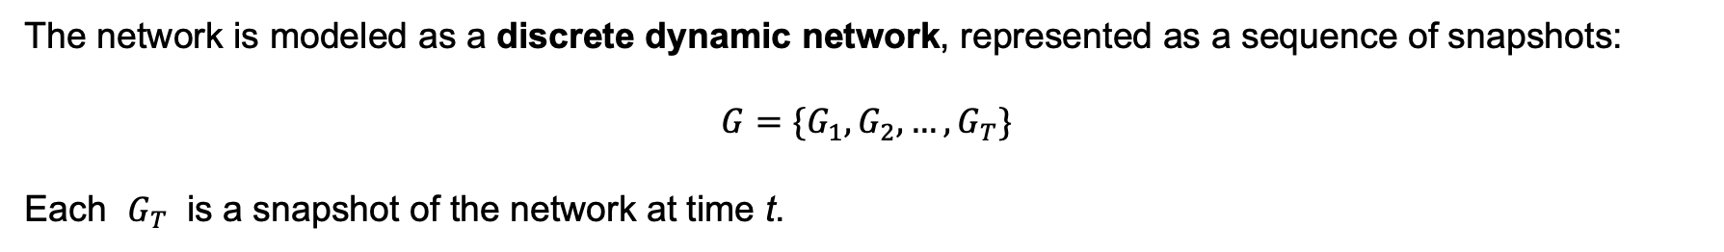
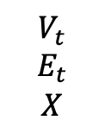
2.1 Dynamic Network Setting
The research is about discrete dynamic social network
The network is modeled as a discrete dynamic network, represented as a sequence of snapshots:
$$G=\{G_{1},G_{2},…,G_{T}\}$$
Each $G_{T}$ is a snapshot of the network at time t.
Definition of Network snapshot:
The state of a social network at a specific time point, including nodes, edges, and features.
$$G_{t}=\left(V_{t},E_{t},X\right)$$
$$V_{t}$$
$$E_{t}$$
$$X$$
Node set at time t
Edge set at time t
Node feature matrix (assumed static)
Author assumes: Node features remain constant, but network structure evolves over time.

Slide 6
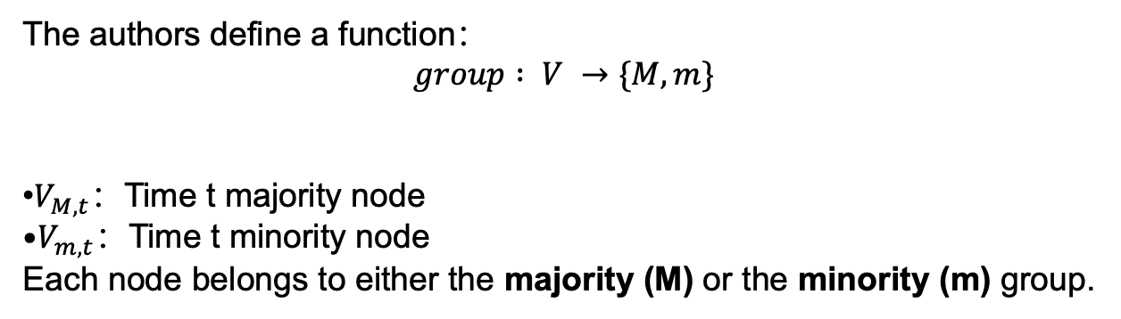
2.2 Demographic groups
The authors define a function：
$$group : V →\{M, m\}$$
​$V_{M,t}$：Time t majority node
$V_{m,t}$：Time t minority node Each node belongs to either the majority (M) or the minority (m) group.

Slide 7
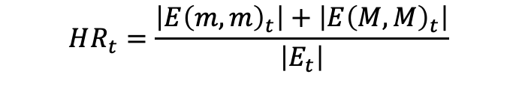

Network Properties
Minority Ratio (MR)
The proportion of minority nodes in the network at time t.
MR = 0.5 means balanced group sizes
Smaller MR indicates stronger underrepresentation
$$MR_{t}=\frac{\left|V_{m,t}\right|}{N_{t}}$$
Homophily Ratio (HR)
The fraction of edges connecting nodes within the same group.
$$HR_{t}=\frac{\left|E{\left(m,m\right)}_{t}\right|+\left|E{\left(M,M\right)}_{t}\right|}{\left|E_{t}\right|}$$
High HR → strong homophily (people connect mostly within their group)
Low HR → heterophily (more cross-group connections)

Slide 8


Network Properties
Edge Density (ED)
The authors differentiate two
(a) Intra-edge density
$$ED\text{−}intra_{t}=\frac{2\left(\left|E{\left(m,m\right)}_{t}\right|+\left|E{\left(M,M\right)}_{t}\right|\right)}{N_{m,t}\left(N_{m,t}−1\right)+N_{M,t}\left(N_{M,t}−1\right)}$$
Measures how dense the connections are within groups relative to all possible intra-group edges.
(b) Inter-edge density
$$ED\text{−}inter_{t}=\frac{\left|E{\left(M,m\right)}_{t}\right|}{N_{m,t}⋅N_{M,t}}$$
Measures how dense the connections are between groups relative to all possible inter-group edges.

Slide 9
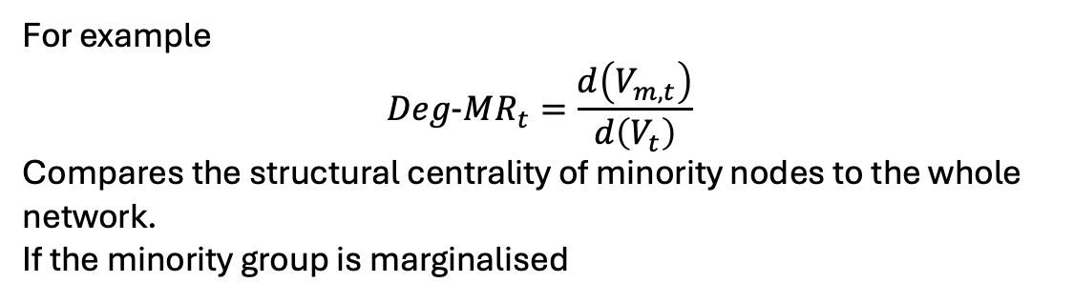
Other properties
The authors also analyse other properties
Average degree-How many neighbors each node has on average
Power-law exponent-Shape of degree distribution (scale-free property)
Clustering coefficient-Probability that my neighbors are also connected
For example
$$Deg\text{-}MR_{t}=\frac{d\left(V_{m,t}\right)}{d\left(V_{t}\right)}$$
Compares the structural centrality of minority nodes to the whole network.
If the minority group is marginalised

Slide 10
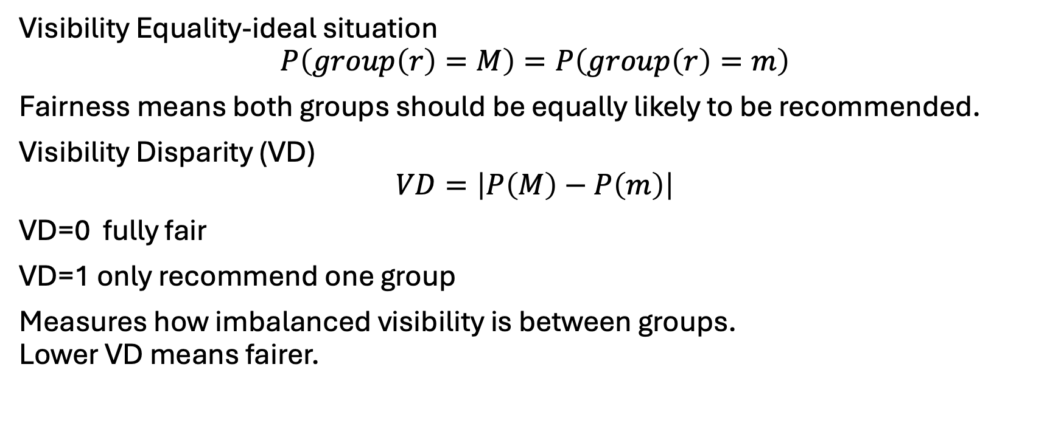
Fairness Metrics- This represents the essence of assessing fairness in recommendation outcomes
Visibility Equality-ideal situation
$$P\left(group\left(r\right)=M\right)=P\left(group\left(r\right)=m\right)$$
Fairness means both groups should be equally likely to be recommended.
Visibility Disparity (VD)
$$VD=\left|P\left(M\right)−P\left(m\right)\right|$$
VD=0 fully fair
VD=1 only recommend one group
Measures how imbalanced visibility is between groups. Lower VD means fairer.

Slide 11
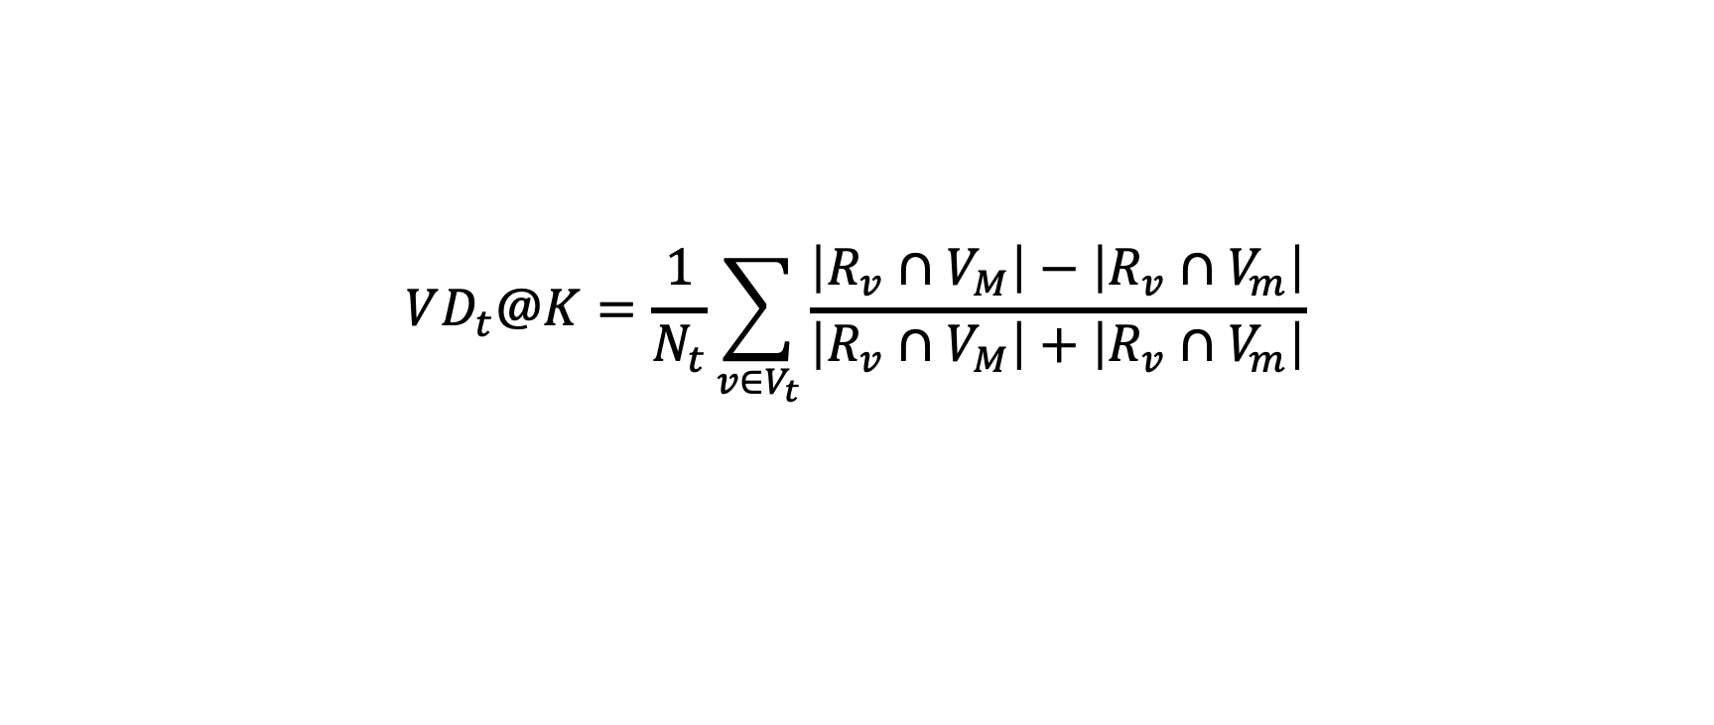
$$VD_{t}@K=\frac{1}{N_{t}}\sum_{v∈V_{t}}{\frac{\left|R_{v}∩V_{M}\right|−\left|R_{v}∩V_{m}\right|}{\left|R_{v}∩V_{M}\right|+\left|R_{v}∩V_{m}\right|}}$$
For each user’s recommendation list, compute the imbalance, then average over all users.

Slide 12
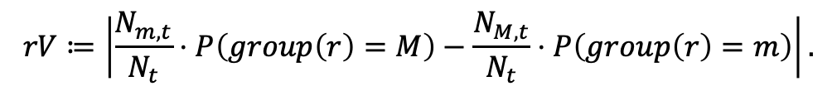
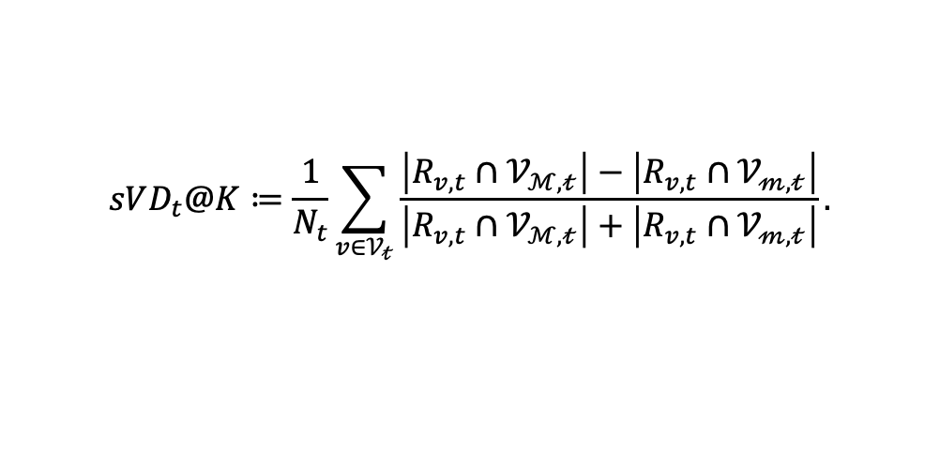
Signed VD (sVD)
$$sVD_{t}@K≔\frac{1}{N_{t}}\sum_{v∈𝒱_{𝓉}}{\frac{\left|R_{v,t}∩𝒱_{ℳ,𝓉}\right|−\left|R_{v,t}∩𝒱_{𝓂,𝓉}\right|}{\left|R_{v,t}∩𝒱_{ℳ,𝓉}\right|+\left|R_{v,t}∩𝒱_{𝓂,𝓉}\right|}}.$$
Positive sVD → majority favored Negative sVD → minority favored
Relative Visibility Disparity (rVD)
$$rV≔\left|\frac{N_{m,t}}{N_{t}}⋅P\left(group\left(r\right)=M\right)−\frac{N_{M,t}}{N_{t}}⋅P\left(group\left(r\right)=m\right)\right|.$$
While VD assumes parity at a 50/50 ratio, real-world group proportions are often imbalanced (e.g., 70/30)
rVD defines fairness relative to group sizes rather than absolute parity.

Slide 13
Experiments setup-Datasets
The paper uses three real-world dynamic social networks: Enron (email communication), Norwegian (board interlock network), and DBLP (academic collaboration), covering corporate, professional, and scholarly domains to improve generalizability.
Enron dataset
an email communication network from the Enron corporation.
Nodes = employees
Edges = email communications
Sensitive attribute = gender (inferred from names)
Features = bag-of-words from email content
28 months
Norwegian dataset
a board-of-directors network.
Nodes = directors
Edges = two directors worked in the same company
Sensitive attribute = gender (given directly)
Features = company memberships (one-hot vectors)
112 months
DBLP dataset
an academic collaboration network.
Nodes = authors
Edges = co-authorship relationships
Sensitive attribute = gender (inferred from names)
Features = word vectors from paper titles
1980-1997
18 years

Slide 14
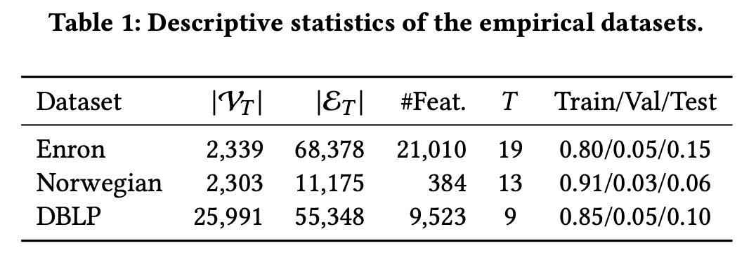
How many users are in the network
How many connections exist
How many features each node has
How many temporal snapshots the network is divided into
Proportions for training / validation / testing

Slide 15
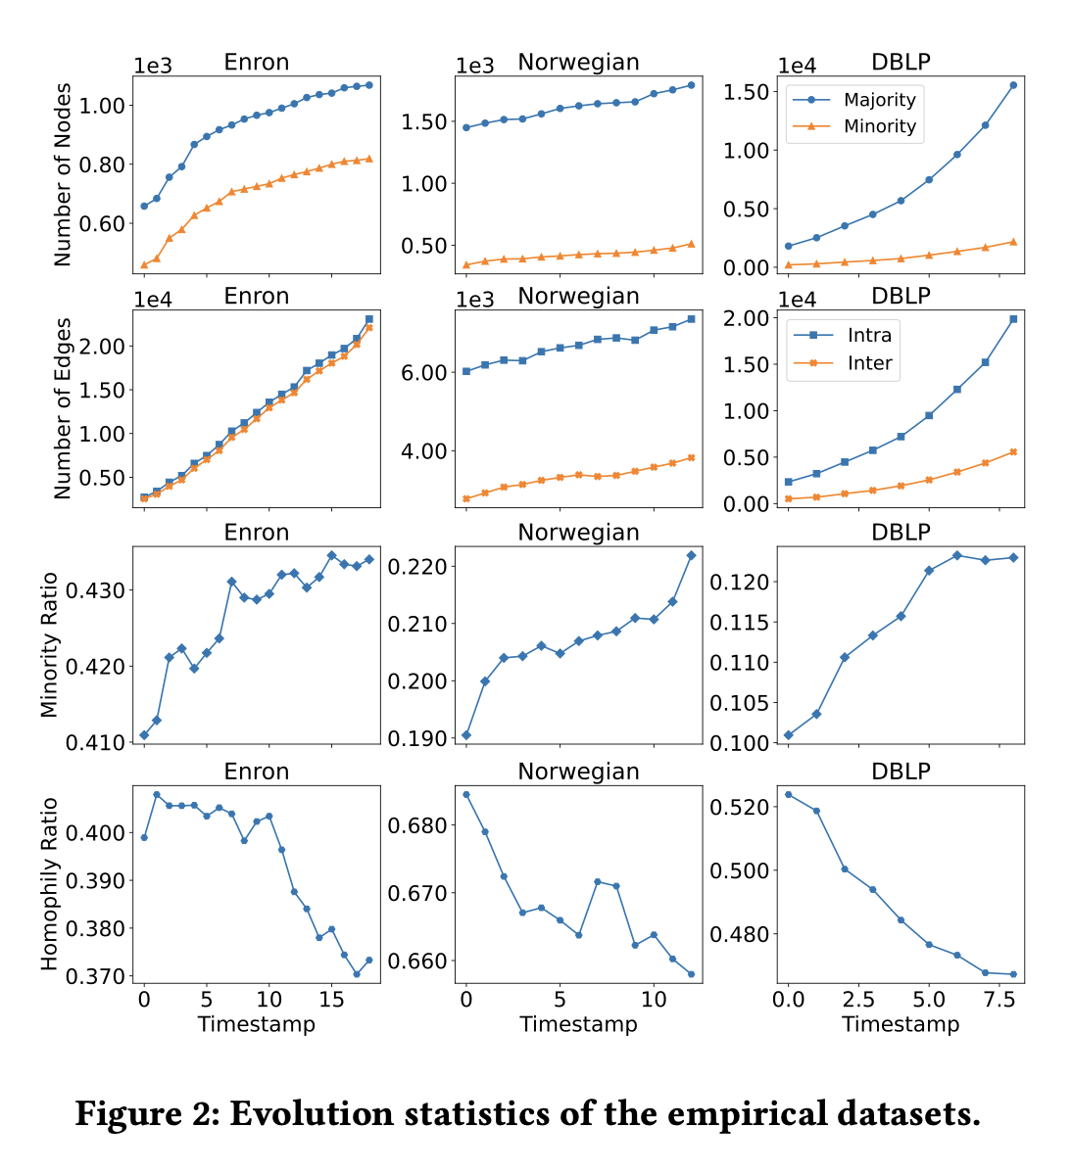
Across all three datasets, we observe the following patterns:
Gender imbalance: males (majority) are consistently more represented than females (minority).
Over time:
The number of nodes and edges increases,
The minority ratio (MR) gradually increases,
The homophily ratio (HR) decreases.
These trends indicate that the networks are evolving toward greater group balance and more cross-group interactions.
But the actual changes in MR and HR are relatively small (no more than 16%). Therefore, in the later experiments (RQ3), the authors use synthetic networks to simulate more extreme variations in these structural properties.

Slide 16
Experiments setup
Recommendation models (Matrix Factorization / Collaborative Filtering)
BPR
NeuMF
NGCF
Evaluation Metrics
The authors evaluate fairness using the following metrics:
VD@K
sVD@K
rVD@K
where K ∈ {20, 50, 100}.
Experimental Settings
Models are trained on the network snapshot at time t
New edges appearing at time t+1 are used for validation and testing
Only new links where both endpoints exist in the training network are kept
The train/validation/test split ratios remain consistent with Table 1 across all timestamps
Model configuration
GNNs: 2 layers, embedding dimension = 64
Learning rate = 0.001
Each model is trained for 100 epochs
Due to the small size of the Enron and Norwegian datasets, each experiment is repeated 5 times and results are averaged
Recommendation Models
Three categories of models are evaluated:
Baselines
Random recommender
Graph Neural Network models
GCN
LightGCN
FairDrop (a fairness-aware model)
Method: node embeddings are learned and cosine similarity is used to rank candidate nodes and select Top-K recommendations.

Slide 17
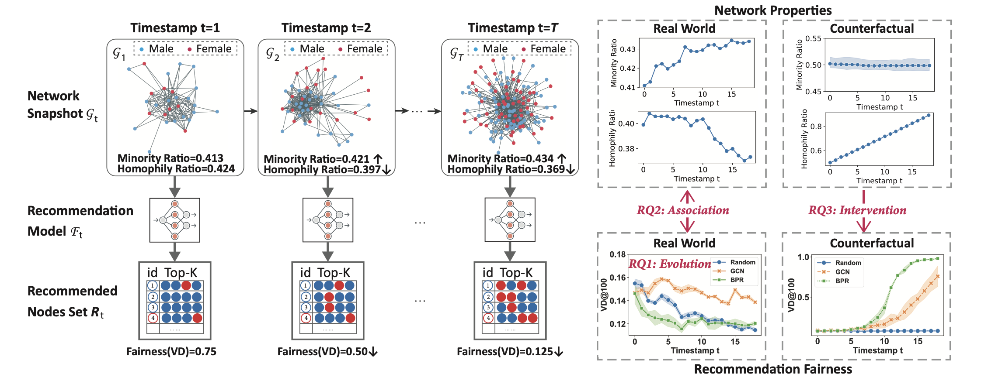
A pipeline diagram summarizing how the paper addresses RQ1 (trend), RQ2 (correlation), and RQ3 (intervention).
Time axis shows snapshots GtGt​. For each snapshot, train a recommender FtFt​ and produce Top-K recommendations RtRt​.
Fairness is measured by VD (lower is fairer).
The “Counterfactual” block illustrates synthetic alternative evolutions (e.g., changing HR) to test causal impact.

Slide 18
RQ1: Fairness Evolution
How does recommendation fairness of various models evolve over time?
They split the network into multiple temporal snapshots. At each timestamp, they train recommendation models and evaluate them on new links appearing at the next timestamp. They then use fairness metrics such as VD, sVD, and rVD to plot how fairness evolves over time.
For each timestamp tt, the authors:
Train the recommendation model on the snapshot Gt,
Predict future links appearing at t+1
Compute fairness metrics (VD, sVD, rVD),
Plot these values over time to observe fairness trends.

Slide 19
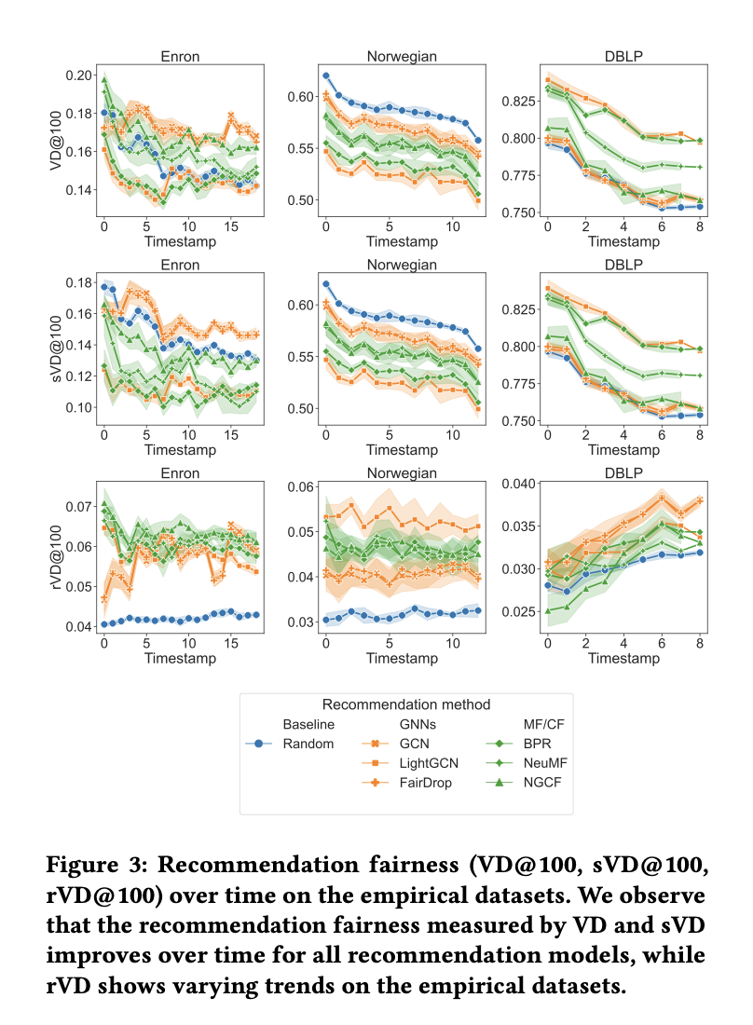
Figure 3 shows the temporal evolution of fairness across different models and datasets. We observe a consistent decrease in VD over time, meaning that recommendation visibility becomes more balanced. This trend holds across Enron, Norwegian, and DBLP, indicating that the phenomenon is not model-specific. However, sVD remains positive, suggesting that despite improvement, recommendations still favor the majority group overall.
The conclusion of RQ1 is that recommendation fairness is not a static property. Instead, it evolves over time, and in real-world dynamic networks, most models tend to become fairer as the network grows.
The model itself does not change over time—the same algorithm is retrained at each timestamp. Therefore, the change in fairness is more likely driven by changes in the underlying network structure rather than improvements in the algorithm, which directly motivates RQ2.

Slide 20
RQ2: Association between Fairness and Network Properties
How is recommendation fairness associated with network properties over time?
MR (Minority Ratio): whether the proportion of minority users increases over time
HR (Homophily Ratio): whether users increasingly connect only with similar people
Plus other properties such as edge density, average degree, and clustering coefficient.

Slide 21
At each timestamp, they compute both:
Fairness metrics (e.g., VD@K)
Network properties (MR, HR, ED, etc.) They then perform correlation analysis (Spearman and Pearson) to identify which properties consistently co-evolve with fairness. In the appendix, they further use regression (random forest) to test which properties best predict fairness.

Slide 22
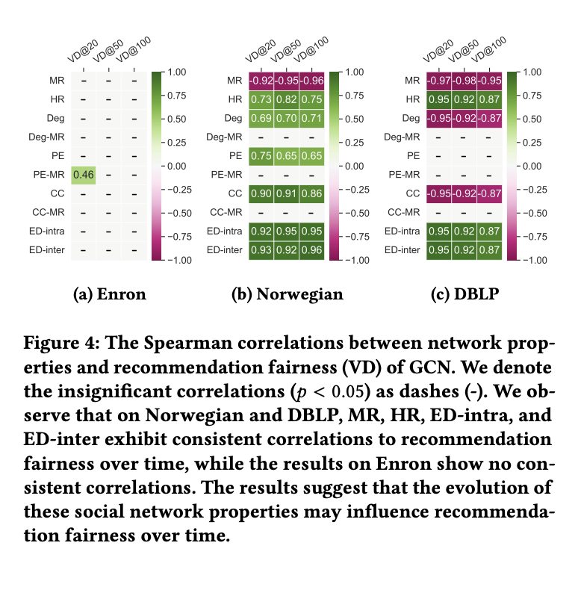
The correlation heatmaps show that Minority Ratio and Homophily Ratio exhibit the most consistent and strongest associations with fairness, especially in the Norwegian and DBLP datasets. Other structural properties show weaker or unstable correlations. This suggests that changes in fairness are more likely driven by structural evolution rather than model behavior.
In the appendix, the authors further conduct a random forest regression experiment and find that using only MR and HR already achieves strong predictive performance for VD, while adding more features brings little improvement.
The conclusion of RQ2 is that the evolution of recommendation fairness is strongly associated with network structure, particularly minority ratio and homophily ratio, which explain fairness changes more effectively than model choice.

Slide 23
RQ3: Impact of Interventions
How do interventions on structural properties impact recommendation fairness over time?
Because MR and HR vary only slightly in real datasets, the authors use counterfactual simulations:
They generate synthetic networks using the BBA model
They force MR or HR to change linearly over time from 0.5 to 0.1 or 0.9
Only one variable is manipulated at a time:
When changing HR, MR is fixed at 0.5
When changing MR, HR is fixed at 0.5
They then run recommendation models on these hypothetical network trajectories and observe how fairness evolves

Slide 24
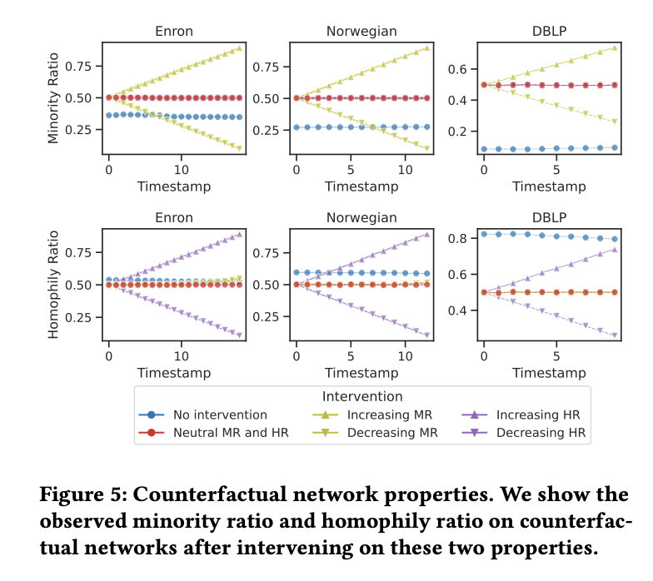
Goal: Test causal impact of network structure on fairness
Use synthetic dynamic networks (BBA generator)
Construct three scenarios:
No intervention (real evolution)
Neutral baseline: MR = 0.5, HR = 0.5
Controlled interventions:
MR: 0.5 → 0.1 and 0.5 → 0.9
HR: 0.5 → 0.1 and 0.5 → 0.9
Change one factor at a time (control variables)
Short takeaway line (optional on slide bottom):
Isolates MR and HR to test causal effects on fairness

Slide 25
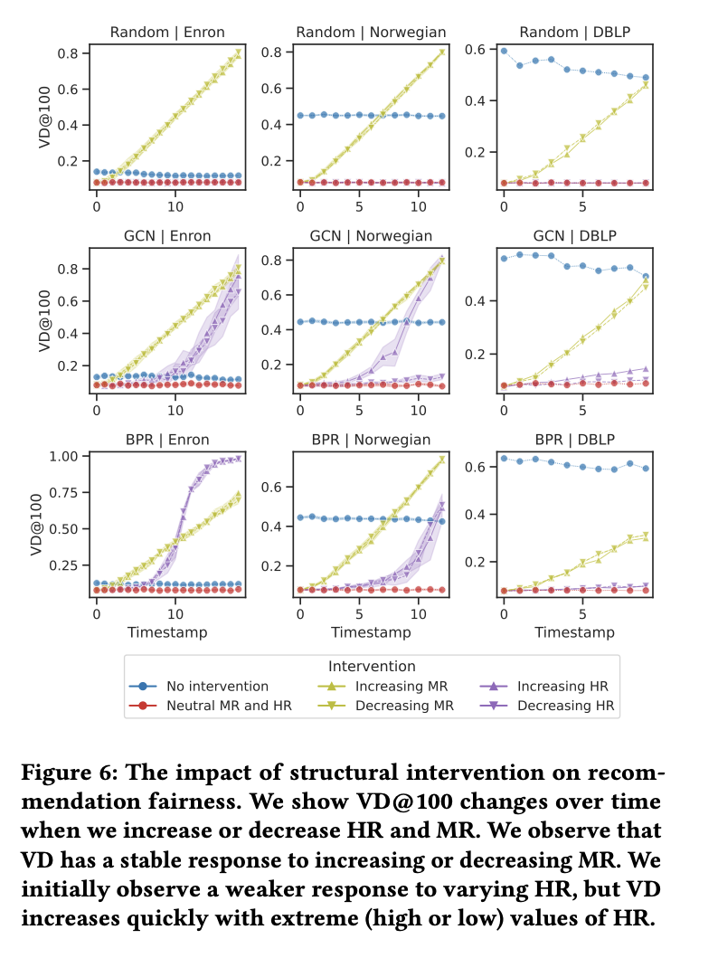
Y-axis: VD@100 (higher = less fair)
X-axis: time (network evolution)
Findings:
MR imbalance → fairness consistently worsens
Extreme HR (very high or very low) → sharp fairness collapse
Effect holds across:
Datasets (Enron, Norwegian, DBLP)
Models (Random, GCN, BPR)
Key insight (strong concluding bullet):
Even with balanced groups (MR = 0.5), extreme structure alone can break fairness

Slide 26
Discussion
Data structure shapes fairness
Underlying data strongly influences fairness
MR ↑, HR ↓ over time
Fairness improves across all models
Structure, not just algorithms, drives fairness
Structural intervention is possible
Fairness can be improved via intervention
Even without “fair” algorithms
Adjusting network structure helps
Avoid extreme homophily / heterophily
Fairness depends on definition
Different fairness metrics → different conclusions
VD, rVD, ranking fairness, utility fairness
No single “universal” fairness metric
Must match application scenario

Slide 27
Practical guidance from the paper
In homophilic networks → encourage cross-group links
In heterophilic networks → encourage within-group links
Avoid extreme structural patterns
Fairness is shaped by data + structure + time
Algorithmic fairness alone is insufficient
Structural governance matters
Fairness definition must match application
Platforms should not rely solely on fair algorithms; they must also consider how to guide network evolution to ensure long-term fairness.

Slide 28
Limitations
Feedback loop
in real-world systems, users are typically part of a recommendation feedback loop and actively interact with the model. Therefore, it is important to consider the feedback effects of recommendations, including whether users accept the recommended items and whether both the network snapshot and user feedback are used for training at subsequent timestamps.
other network properties
other network properties could be further explored to provide a more comprehensive understanding of network structure and dynamics. In particular, the results in Section 3.3 suggest that interventions on edge density may lead to interesting insights. Moreover, the complex interplay among different factors that contribute to network formation and evolution remains an open area for future investigation.

Slide 29
Related work
The authors organize prior work into three lines:
Fairness in recommender systems
Recommender systems often exhibit biases (e.g., gender, race).
Two major fairness notions:
Group fairness: treat groups equally
Individual fairness: treat similar individuals similarly
Common methods:
Regularization and constraints
Adversarial learning
Reinforcement learning
Causal approaches
This line focuses on designing fairer algorithms.
Fairness in social recommendation
In social recommendation, biased systems can lead to the glass ceiling effect.
Homophily can further reduce minority visibility.
Prior work proposes fair link prediction methods:
Fair embeddings
FLIP (adversarial + supervised link prediction)
FairLP (modifying network structure)
This line starts to consider both algorithms and network structure.
Temporal fairness in machine learning
Most fairness studies assume static settings.
Real-world systems are dynamic:
Users evolve
Data changes
Feedback loops exist
Prior work shows:
Static fairness approaches often fail in the long run
Temporal dynamics must be considered
Fairness should be studied over time, not only at one snapshot.

Slide 30
Conclusion
Fairness in recommendation evolves over time
Fairness is strongly associated with network structure (MR, HR, ED)
Extreme homophily / heterophily harms fairness
Structural interventions can causally influence fairness
Fairness is not only an algorithm issue, but also a data structure issue
Future Work
Designing algorithms that explicitly improve long-term fairness
Modeling feedback loops between users and recommender systems
Studying richer structural interventions

Slide 31
Critical Thinking - from data, methods and theory
Gender labels inferred from names
Enron & DBLP use name-based gender inference
Potential errors (cross-cultural names, initials)
Affects MR, HR, and fairness evaluation
Issue: Different metrics → different conclusions
VD suggests fairness improves
rVD shows little improvement
Fairness conclusion not robust
Limited dataset diversity
Only three datasets
All are professional networks
No large-scale public social platforms (e.g., Twitter)
Counterfactual relies on synthetic model
BBA is a simplified generator
Assumes specific network dynamics
Causality only holds inside the model
VD is inherently sensitive to group ratio
VD assumes ideal fairness = 50/50 exposure
When MR increases → VD naturally decreases
Improvement may be metric-driven, not behavior-driven
Fairness = statistical parity?
Assumes equal exposure = fair
Ignores:
Opportunity fairness
User preference
Historical inequality
Normative fairness varies by application

Slide 32
Thank you for your listening

